Slide 1
Linear regression

Slide 2
Motivation
Measures of association quantify degree of correlation between 2 variables but they do not tell us about their functional relationship.
Pizza delivery example: the temperature is negatively correlated with delivery time. But we cannot (yet) answer the question: if the delivery time is 32 min, what is the temperature?
Any association of interest might depend on more than 1 variable: e.g. temperature of the pizza might depend on delivery time and on the branch of restaurant it was delivered from.

Slide 3
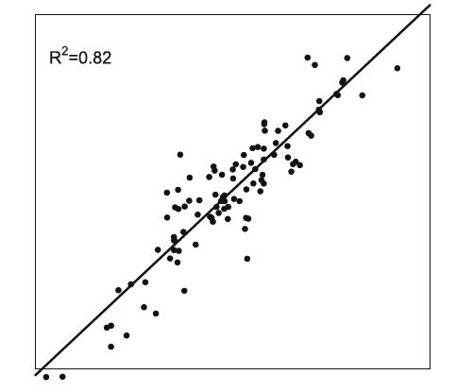
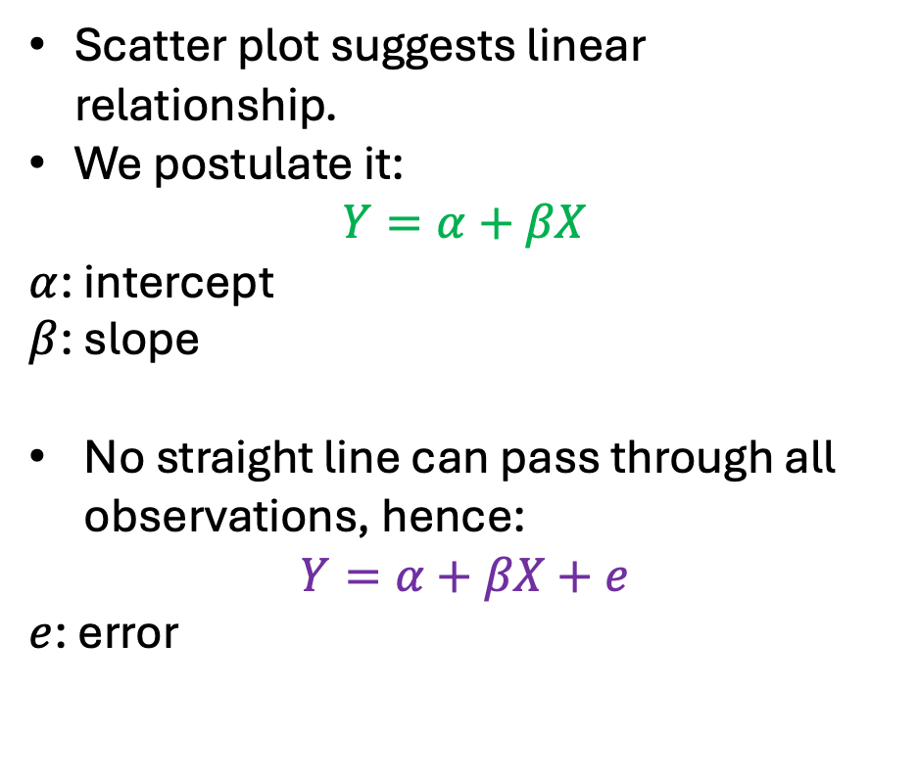
Linear model
Scatter plot suggests linear relationship.
We postulate it:
$$Y=α+βX$$
$α$: intercept
$β$: slope
No straight line can pass through all observations, hence:
$$Y=α+βX+e$$
$e$: error

Slide 4
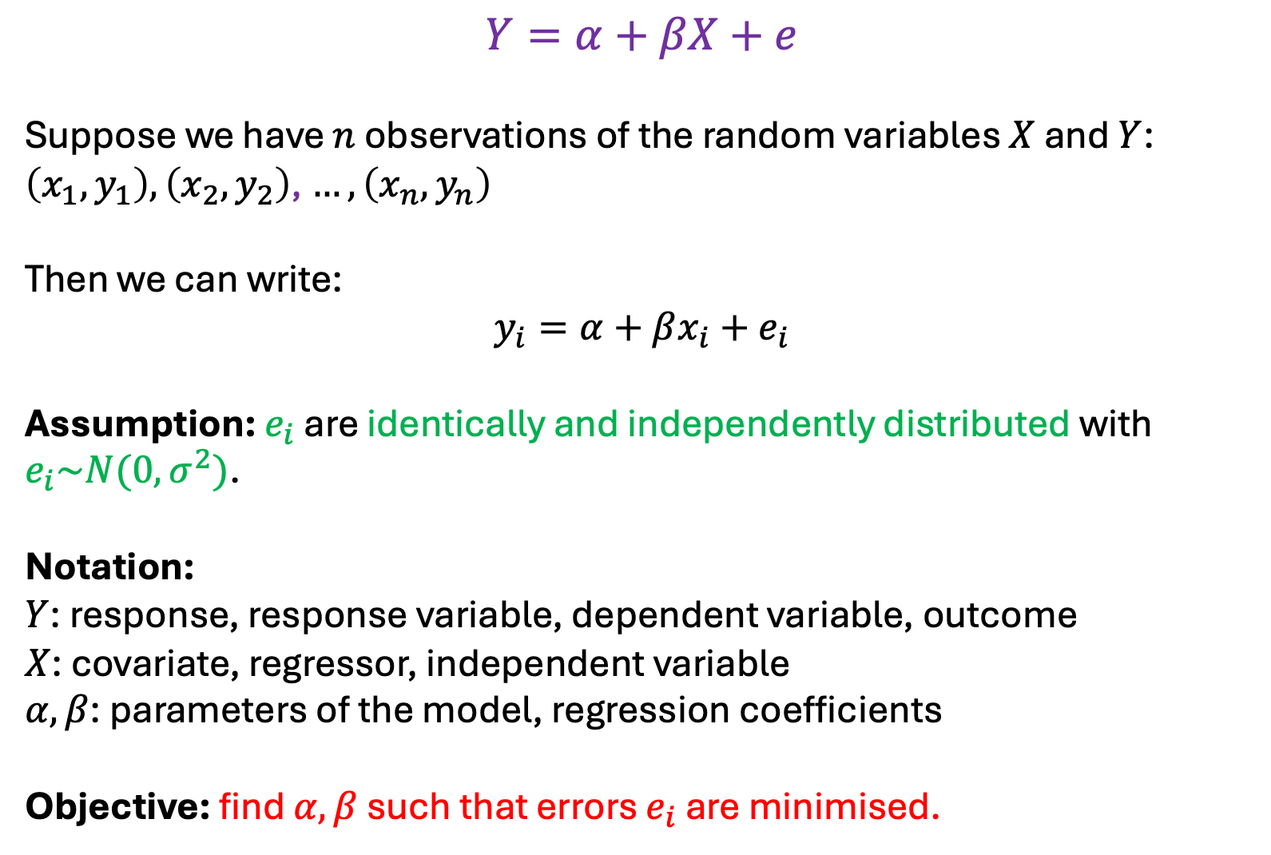
$$Y=α+βX+e$$
Suppose we have $n$ observations of the random variables $X$ and $Y$:
$\left(x_{1},y_{1}\right),\left(x_{2},y_{2}\right)$, $…, \left(x_{n},y_{n}\right)$
Then we can write:
$$y_{i}=α+βx_{i}+e_{i}$$
Assumption: $e_{i}$ are identically and independently distributed with $e_{i}\sim N(0,σ^{2})$.
Notation:
$Y$: response, response variable, dependent variable, outcome
$X$: covariate, regressor, independent variable
$α, β$: parameters of the model, regression coefficients
Objective: find $α, β$ such that errors $e_{i}$ are minimised.

Slide 5
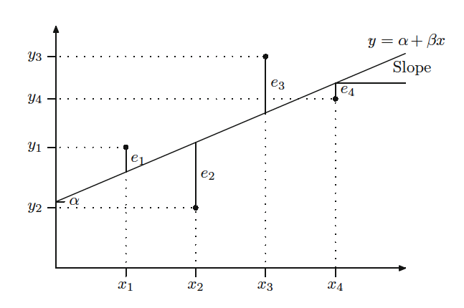
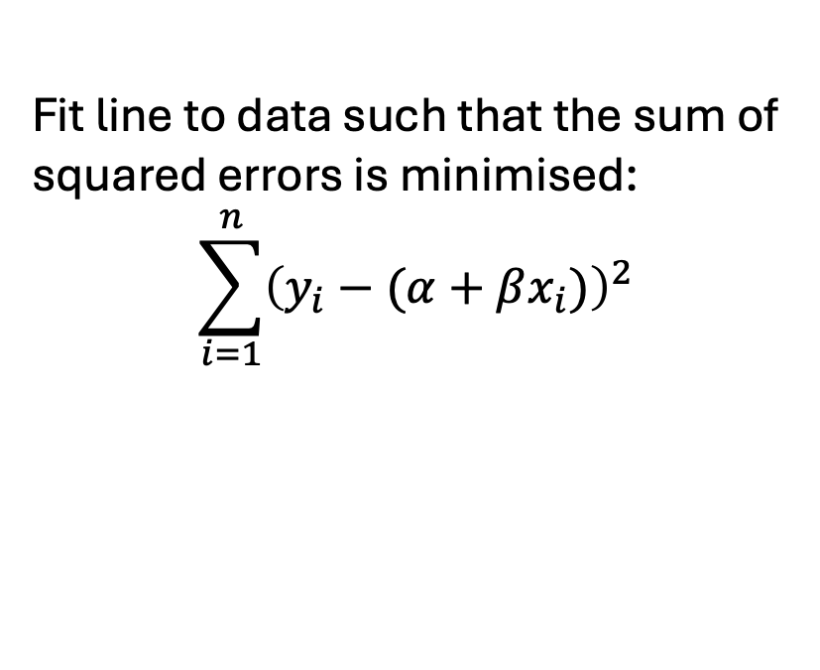
Method of Least Squares
Fit line to data such that the sum of squared errors is minimised:
$$\sum_{i=1}^{n}{{\left(y_{i}−(α+βx_{i})\right)}^{2}}$$
observed value
predicted value

Slide 6
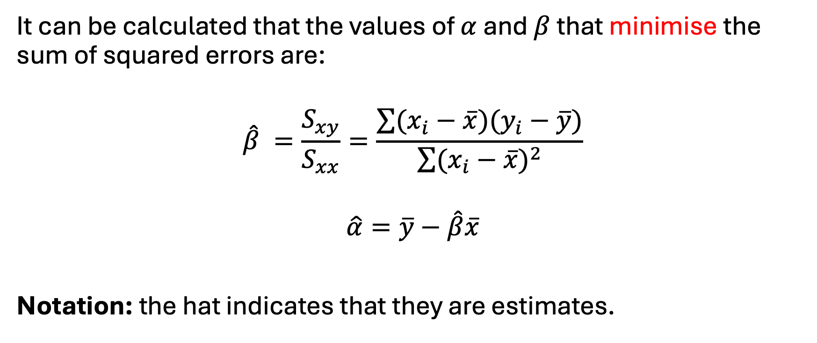
Method of Least Squares
It can be calculated that the values of $α$ and $β$ that minimise the sum of squared errors are:
$$\hat{β} =\frac{S_{xy}}{S_{xx}}=\frac{\sum{(x_{i}−\overline{x})(y_{i}−\overline{y})}}{\sum{{(x_{i}−\overline{x})}^{2}}}$$
$$\hat{α}=\overline{y}−\hat{β}\overline{x}$$
Notation: the hat indicates that they are estimates.

Slide 7

Method of Least Squares
Fitted model:
$$y=\hat{α}+\hat{β}x$$
Residuals:
${\hat{e}}_{i}=y_{i}−{\hat{y}}_{i}=y_{i}$-($\hat{α}+\hat{β}x_{i})$

Slide 8
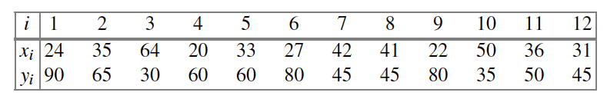



Example
A physiotherapist records the time $X$ (min) that each patient exercises and the time needed for recovery $Y$ (days):

Slide 9
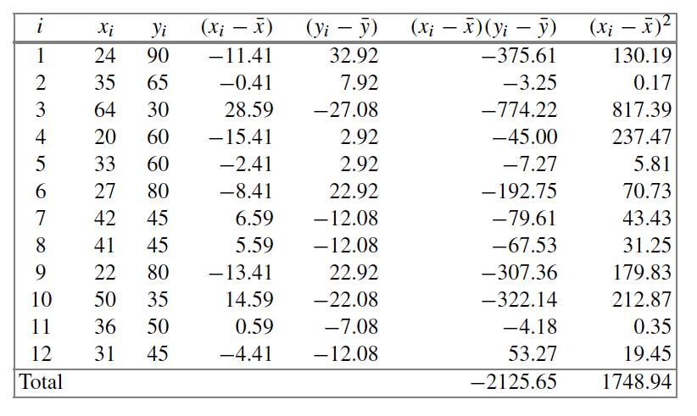
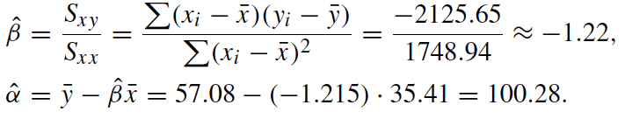

To estimate parameters for the linear regression we need:

Slide 10
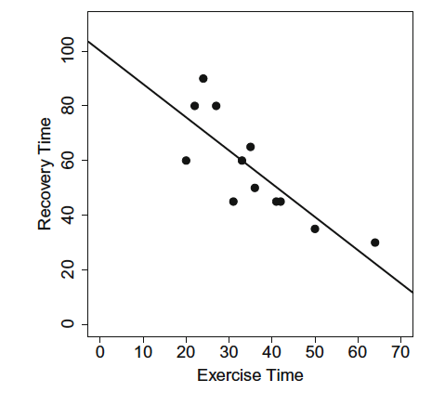
Interpretation:
An increase of 1 min of exercise leads to a decrease of 1.22 days of recovery time.
Two patients who differ in 10 minutes in their exercise have a difference of 12.2 days in recovery.
If a patient did not exercise at all, the model predicts a recovery time of 100.28 days. However, this is beyond the observation range and hence it is dangerous to extrapolate (we do not have evidence outside the observed range).

Slide 11
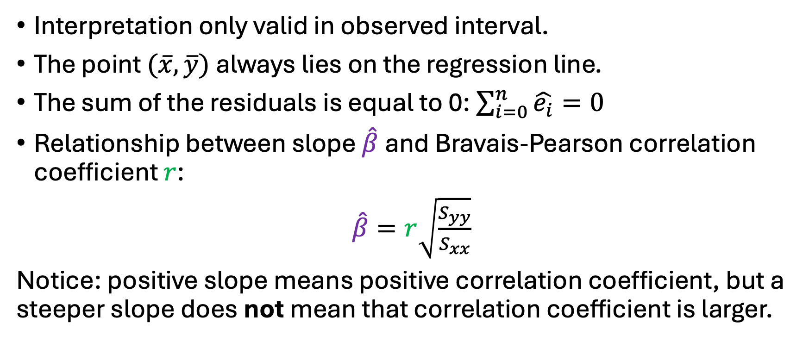
Properties of the linear regression line
Interpretation only valid in observed interval.
The point $(\overline{x},\overline{y})$ always lies on the regression line.
The sum of the residuals is equal to 0: $\sum_{i=0}^{n}{\hat{e_{i}}=0}$
Relationship between slope $\hat{β}$and Bravais-Pearson correlation coefficient $r$:
$\hat{β}=r\sqrt{\frac{S_{yy}}{S_{xx}}}$
Notice: positive slope means positive correlation coefficient, but a steeper slope does not mean that correlation coefficient is larger.

Slide 12
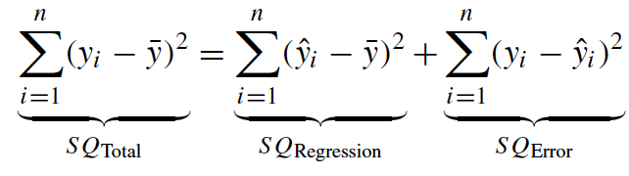
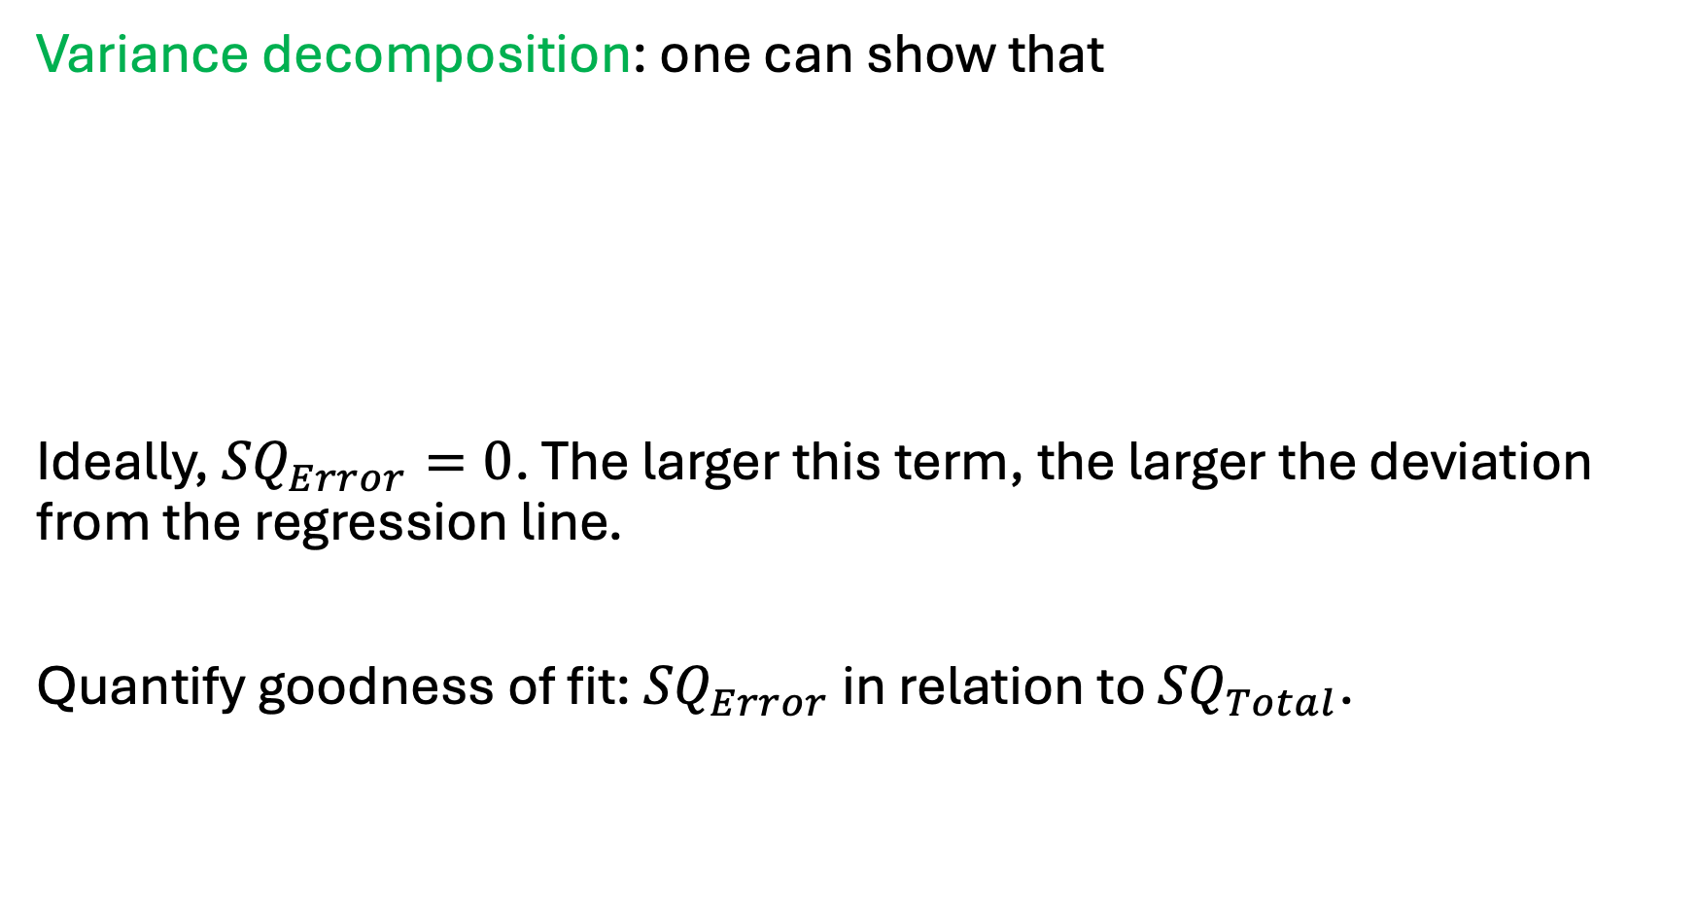
Goodness of fit
Variance decomposition: one can show that
Ideally, ${SQ}_{Error}=0$. The larger this term, the larger the deviation from the regression line.
Quantify goodness of fit: ${SQ}_{Error}$ in relation to ${SQ}_{Total}$.

Slide 13
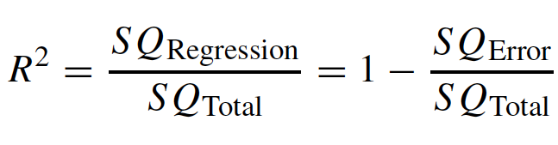

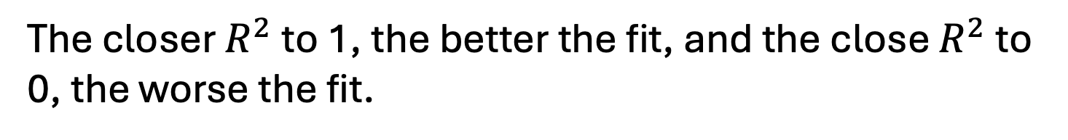
Goodness of fit
$$0≤R^{2}≤1$$
The closer $R^{2}$ to 1, the better the fit, and the close $R^{2}$ to 0, the worse the fit.

Slide 14
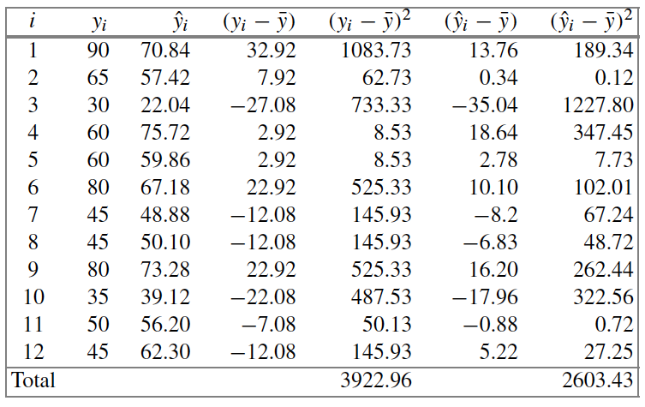
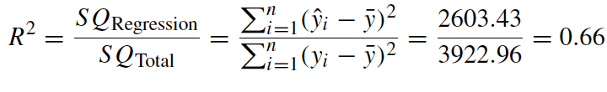
Example: exercise and recovery time
Reasonable but not perfect fit to the data: about 66% of the variability in the data can be explained by the fitted model. The rest is random error.

Slide 15
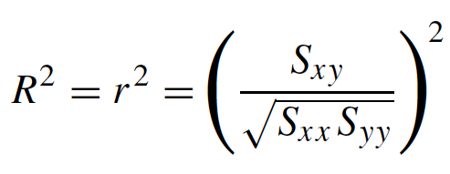
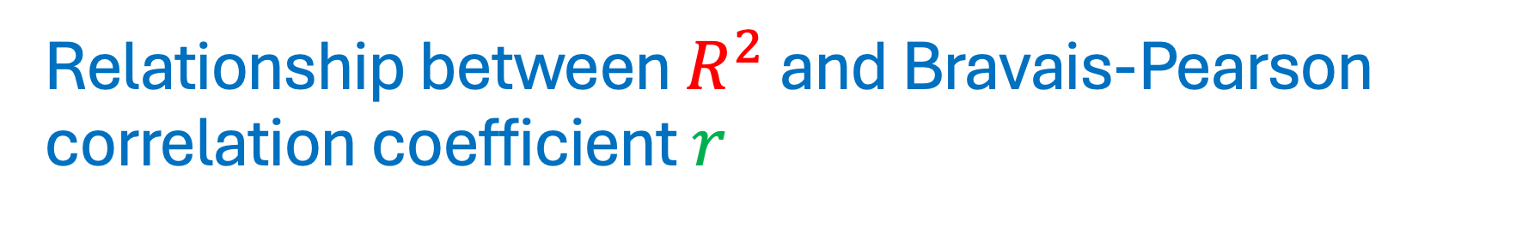
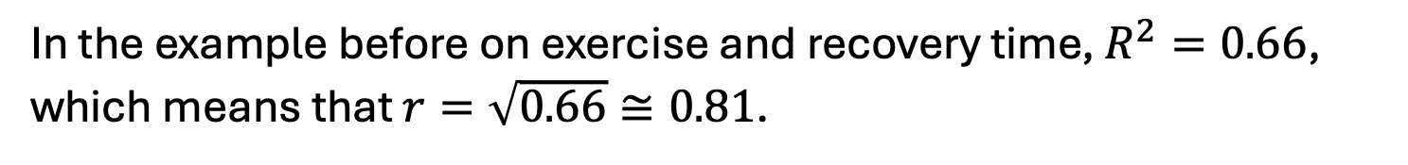
Relationship between $R^{2}$ and Bravais-Pearson correlation coefficient $r$
In the example before on exercise and recovery time, $R^{2}=0.66$, which means that $r=\sqrt{0.66}≅0.81$.

Slide 16
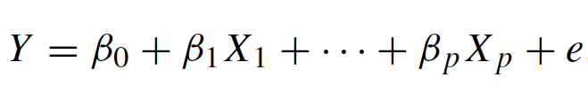
Linear regression with multiple covariates
We can extend our linear model to include more independent variables that affect our dependent variable:
For example, the delivery time of the pizza could be influenced by the driver, amount of food ordered, the operator, whether it is a weekend or not, etc.

Slide 17
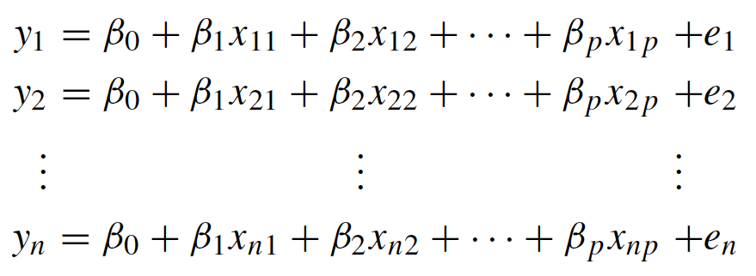

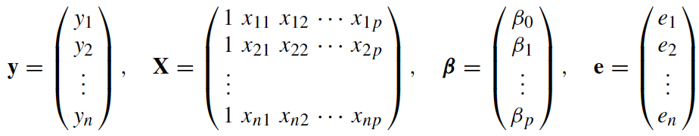

Multiple covariates: matrix notation
Suppose we have a set of $n$ observations.
Short notation in matrix form

Slide 18

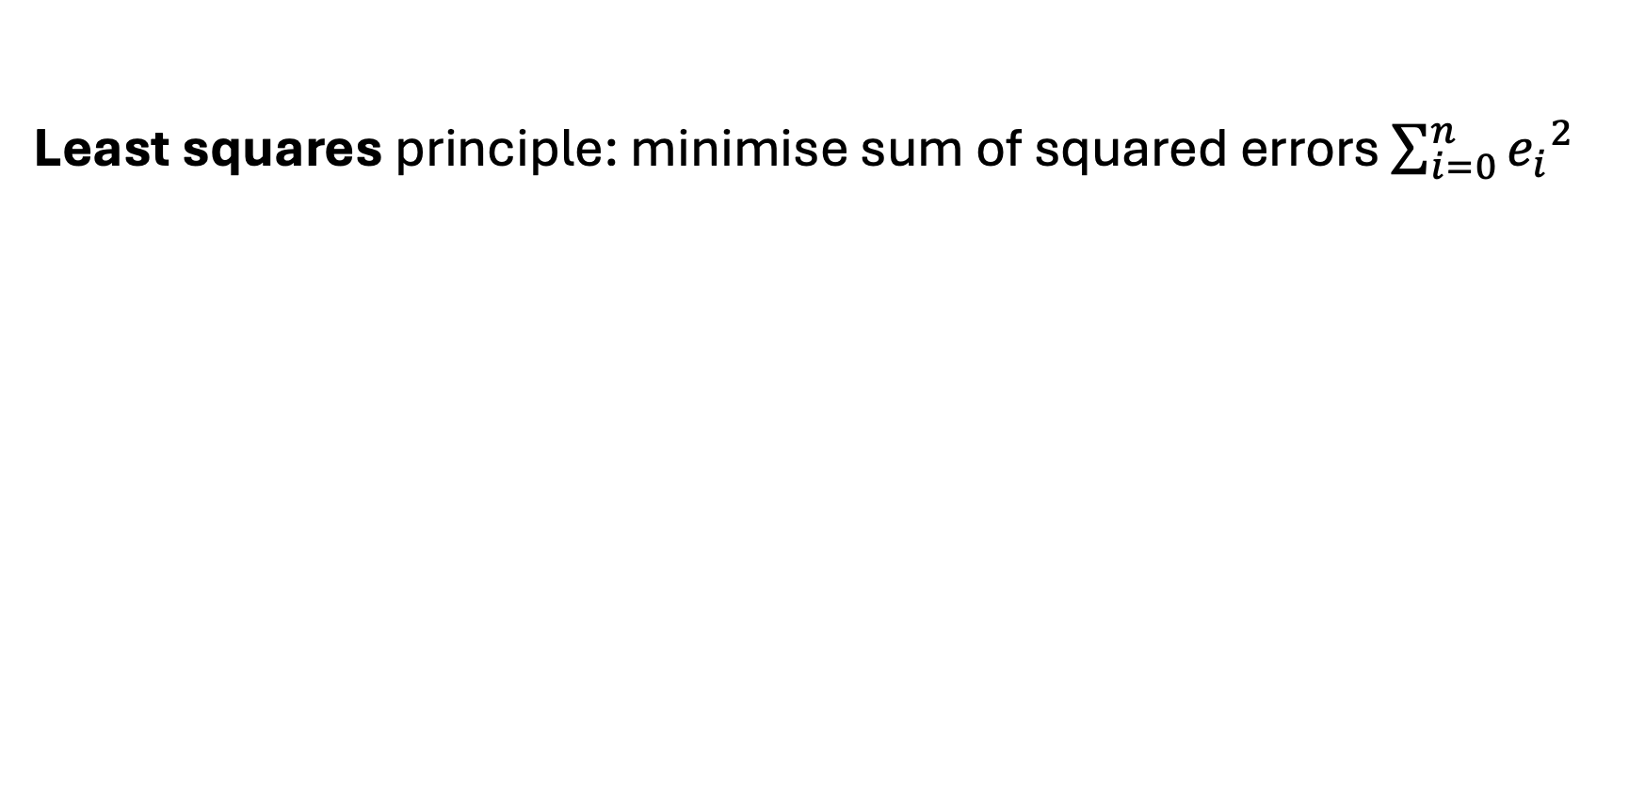
Multiple covariates: matrix notation
Least squares principle: minimise sum of squared errors $\sum_{i=0}^{n}{{e_{i}}^{2}}$
transpose
inverse
Example to be seen in implementation notebook.

Slide 19


Multiple covariates: vector notation
Alternatively, we can use the following vector notation:

Slide 20


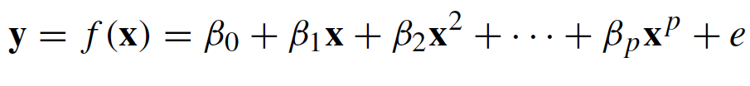
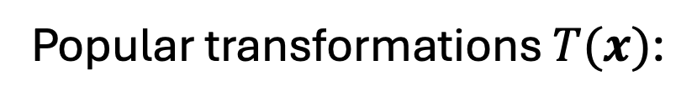
Transformations
Popular transformations $T(x)$:
Choice of $T\left(x\right)$ motivated by application and data.
Alternatively, the relation between $x$ and $y$ can be modelled via a polynomial:

Slide 21
Example: exercise and recovery time
We can fit these 3 different models and compare the results

Slide 22
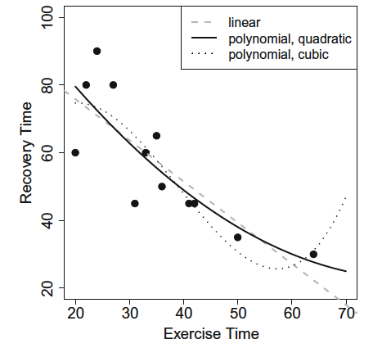
Example: exercise and recovery time
Visually, quadratic polynomial fits the data slightly better than linear one.
Cubic polynomial seems even closer to the data, but interpretation is questionable: based on a single point, the fit suggest an increased recovery time for exercising time more than 65 min.
Trade-off between fit and parsimony: how well a model can be understood if it becomes more complex.

Slide 23

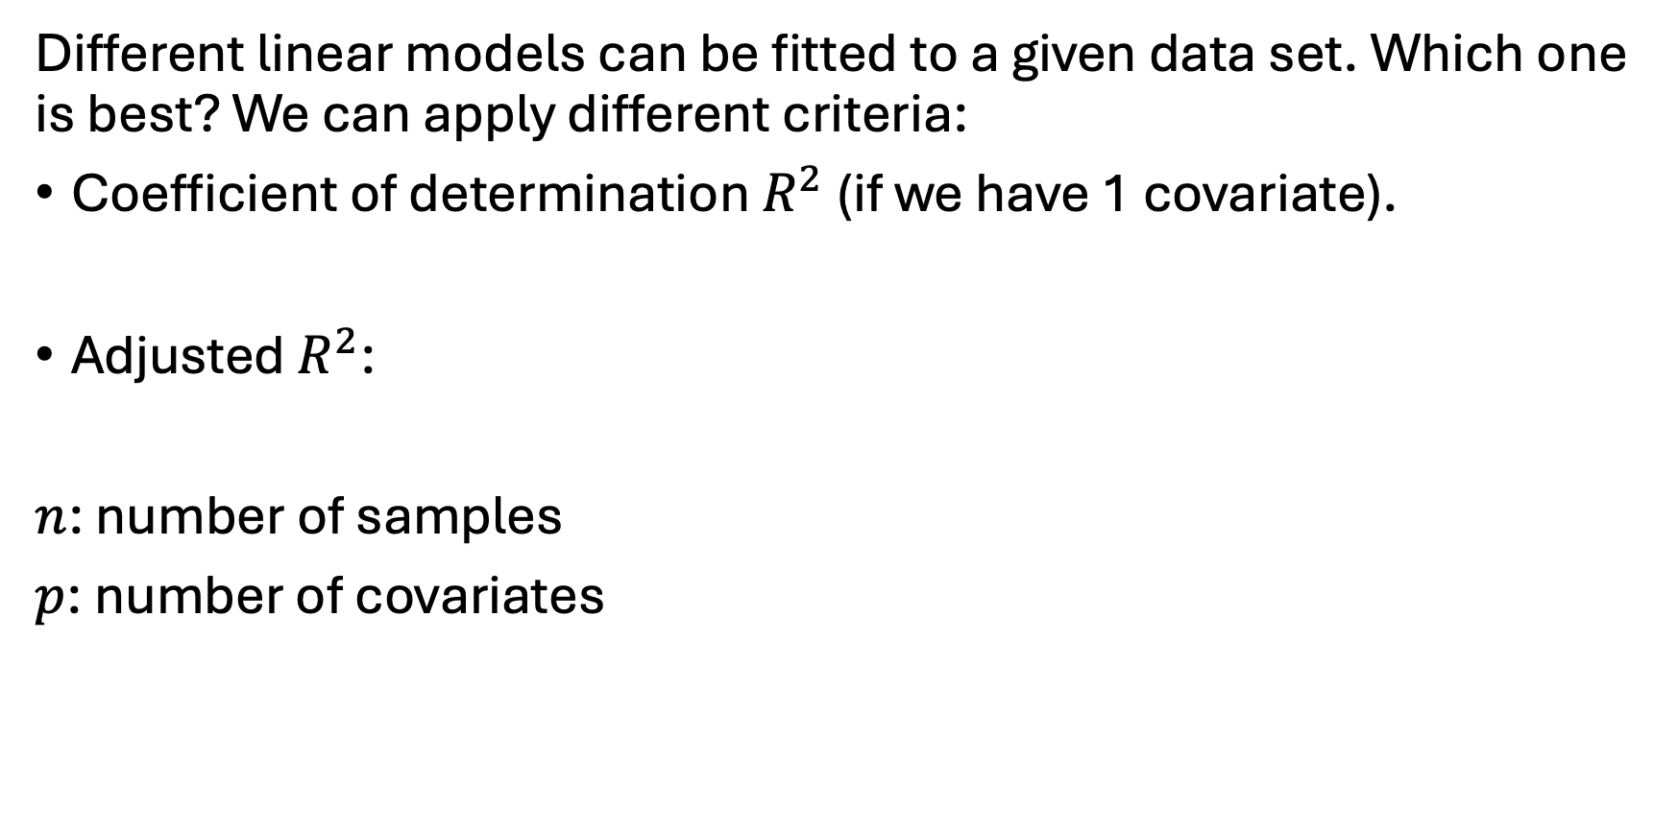
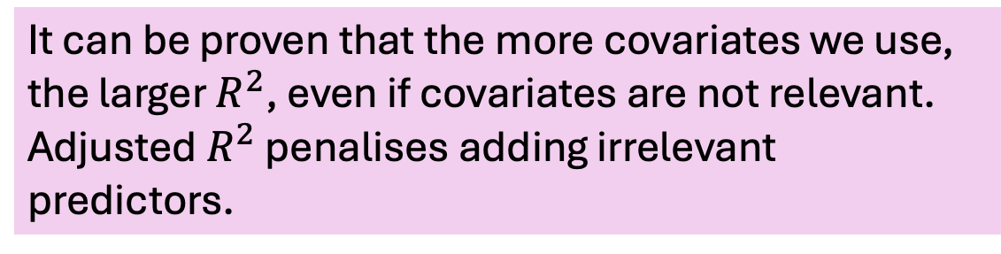
Comparing different models
Different linear models can be fitted to a given data set. Which one is best? We can apply different criteria:
Coefficient of determination $R^{2}$ (if we have 1 covariate).
Adjusted $R^{2}$:
$n$: number of samples
$p$: number of covariates
It can be proven that the more covariates we use, the larger $R^{2}$, even if covariates are not relevant.
Adjusted $R^{2}$ penalises adding irrelevant predictors.

Slide 24
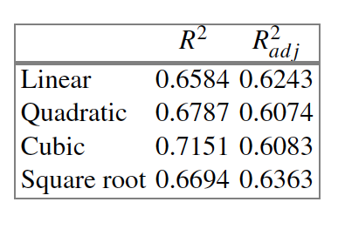
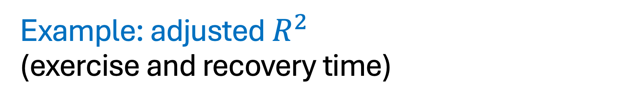
Example: adjusted $R^{2}$ (exercise and recovery time)
Quadratic and cubic models are worse than linear one.
Square root model better than linear one.

Slide 25

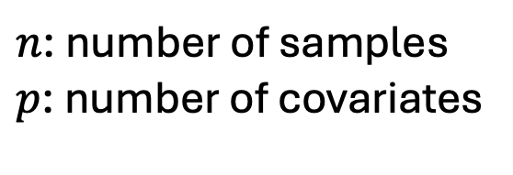
Comparing different models
Akaike’s Information Criterion (AIC) for the linear model
$n$: number of samples
$p$: number of covariates

Slide 26
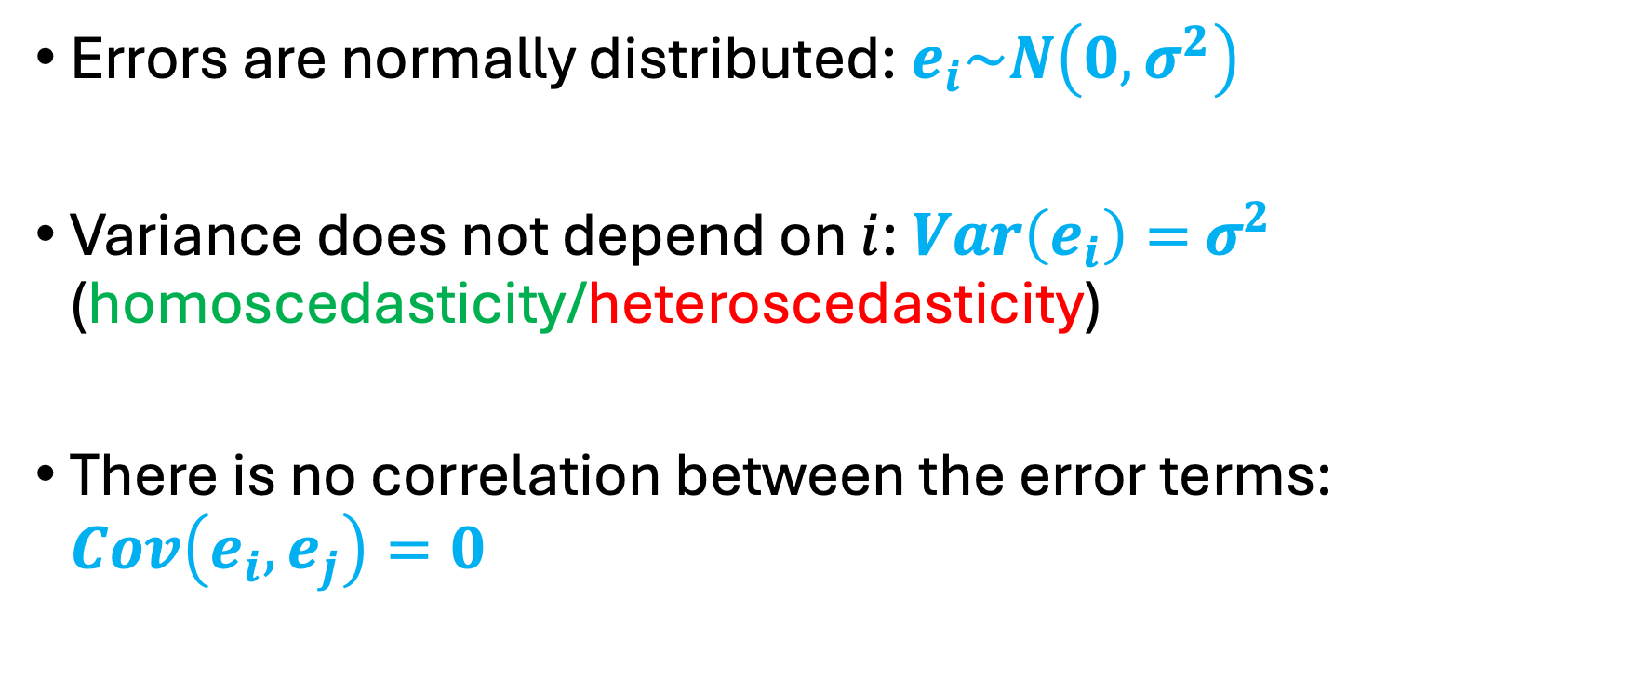
Checking model assumptions
Errors are normally distributed: $e_{i}\sim N\left(0,σ^{2}\right)$
Variance does not depend on $i$: $Var\left(e_{i}\right)=$ $σ^{2}$ (homoscedasticity/heteroscedasticity)
There is no correlation between the error terms: $Cov\left(e_{i},e_{j}\right)=0$

